Slide 1
“Leveraging Natural Language Processing and Machine Learning to Accelerate Life-Saving 911 Care."
Harshini Kavuru, Aditi Laturkar, Rama Naboulsi

Slide 2
Agenda
Introduction & Motivation
Problem Statement​
Hypothesis
Goals
Methodology
Basic Approach
Improved methods
Methods Validation and results comparison
Strength and weakness of methods
Hypotheses Validation
Future work
References

Slide 3
Motivation and Significance:​
The most severe problem today's 911 centers face is understaffing and a less experienced workforce.
It is also very tedious for the operator to carefully listen to all the calls and analyze the situation precisely. This increases the scope for error.
The overwhelming number of calls and data that operators must manage in today's dispatch systems is a typical issue, making it challenging to select and dispatch the appropriate vehicle for each emergency rapidly.
We aim to build a model that analyzes 911 calls in real-time and assists dispatchers in determining whether patients are suffering from a heart attack, stroke, cardiac arrest, or trauma so that the appropriate service can be dispatched.

Slide 4
Problem Statement
Problem:
There is a high risk of mishaps caused by understaffing and the limitations of human dispatchers when receiving 911 emergency calls.
Goals:
To develop a real-time machine learning model to assist dispatchers in determining the emergency services needed for heart-attacks, strokes, cardiac arrest, and trauma.
To create a scoring system to measure the quality of the dispatcher's decision-making process, with the aim of improving emergency response outcomes.

Slide 5
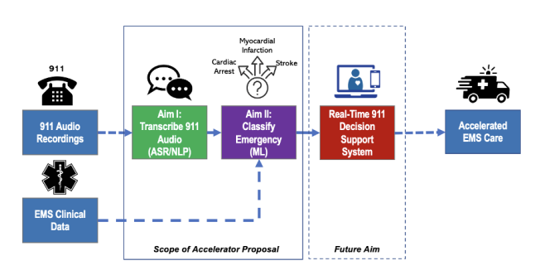
Hypothesis
This study hypothesizes that implementation of natural language processing techniques in the analysis of 9-1-1 calls will enable the development of a machine learning model that can improve the efficiency of 9-1-1 care centers, leading to the dispatch of accurate resources and real-time decision-making support for dispatchers.
4
4

Slide 6
Background Research:
Traditional dispatch systems in various countries
Efficiency of the traditional systems
New techniques implemented to improve the efficiency of traditional systems.
Introduction, expectation and evolution of cad’s
Gap in research
Methods for model implementation
7

Slide 7
Methodology

Slide 8
Basic Approach:
Converting the audio to text
Cleaning the text.
Training the model.
Testing the model.
Saving and loading the model.
Extracting Address
Linking Audio files to EMS data

Slide 9
Improved Model

Slide 10
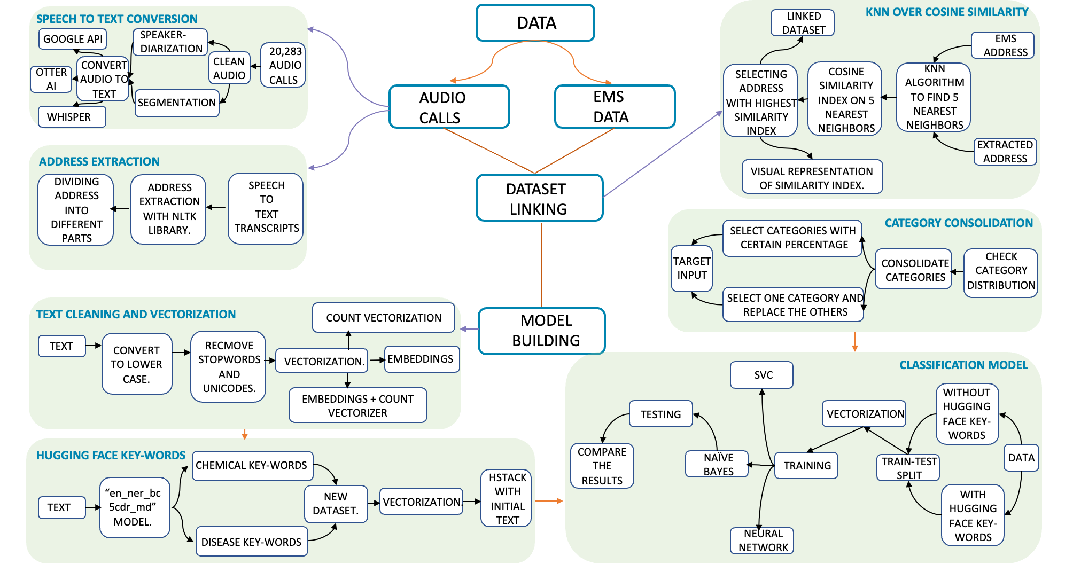
BACKROUND RESEARCH:

Slide 11
Dataset linking:
Two datasets:​
The first contains all audio files, and​
The second is the EMS dataset.​
Our primary objective is to align the audio files with their corresponding "First Impression" data available within the EMS dataset based on address mapping.
Methods used -
FuzzyMatcher
Cosine similarity index
KNN over Cosine similarity
Comparison: After going through the output the KNN over Cosine Similarity performed better than the rest two approaches.
​

Slide 12
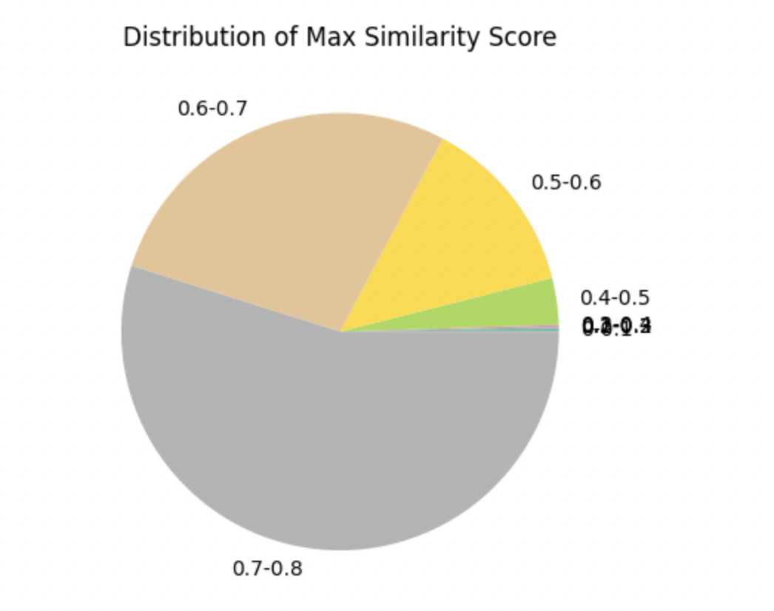
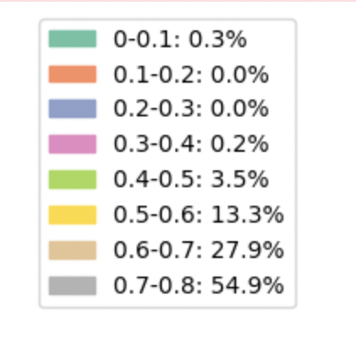
KNN Over Cosine Similarity Results

Slide 13
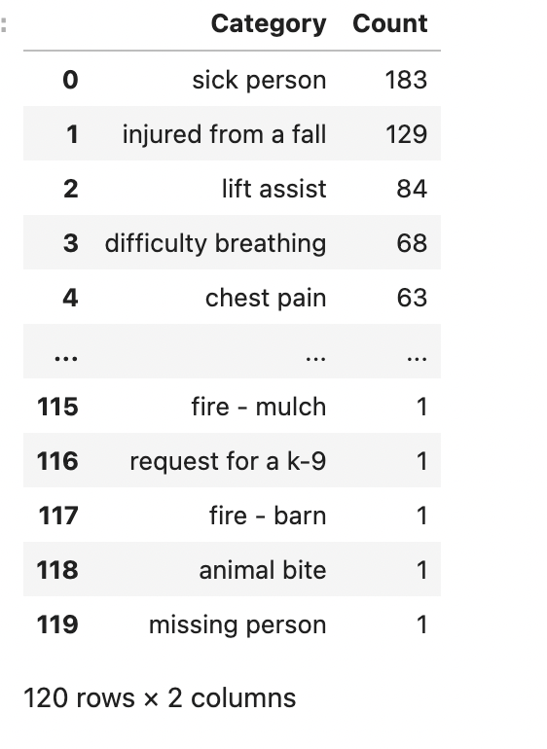
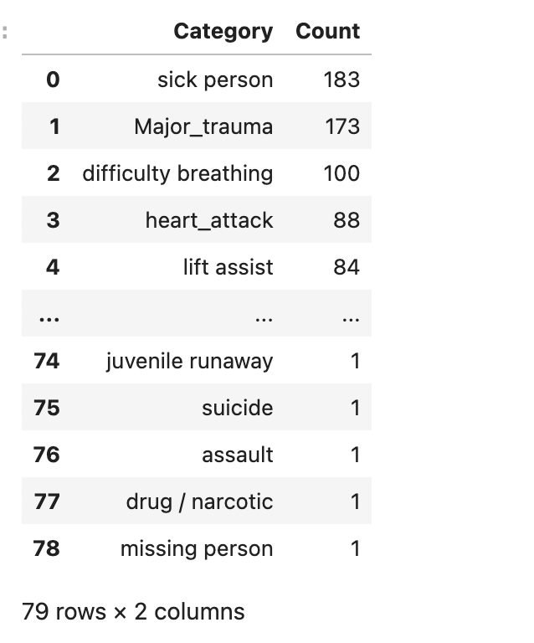
Category Consolidation:
Before
After
Initially, there were 120 different categories of calls.
However, our objective was to minimize the total number of categories for the model.
To achieve this, we carried out a consolidation of categories by grouping similar ones together and removing redundant categorizes by text cleaning.

Slide 14
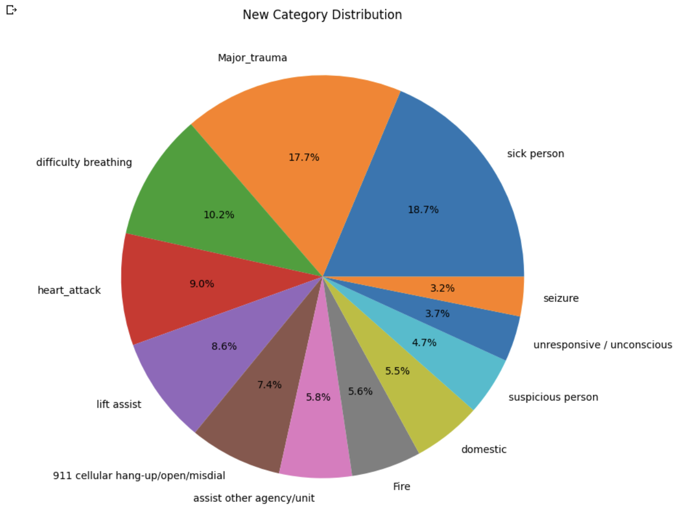
CATEGORY CONSOLIDATION RESULTS:

Slide 15
Vectorization:
Two ways to vectorize the text:
Count vector
Embedding
Results were obtained by using both the classification models using different ways to vectorize the text.
The results were graphically compared to understand which kind of vectorization performed well.

Slide 16
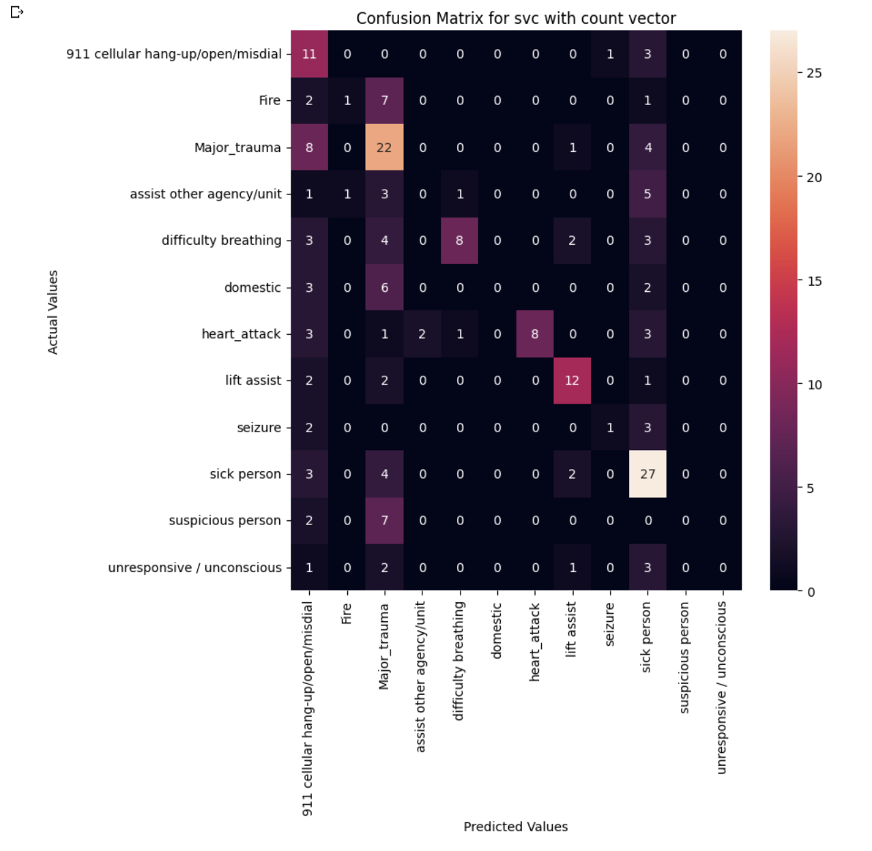
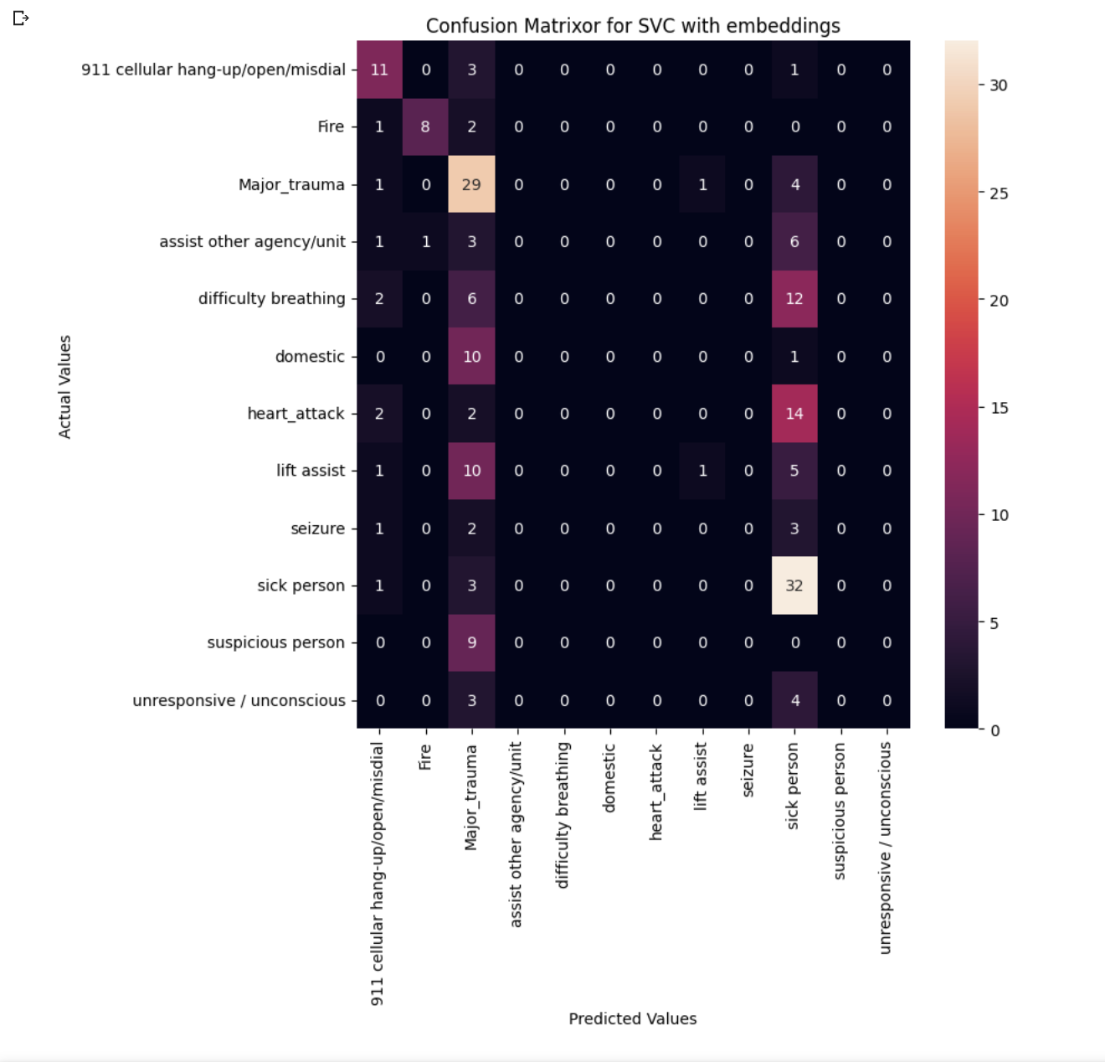
Confusion Matrices for SVC:

Slide 17
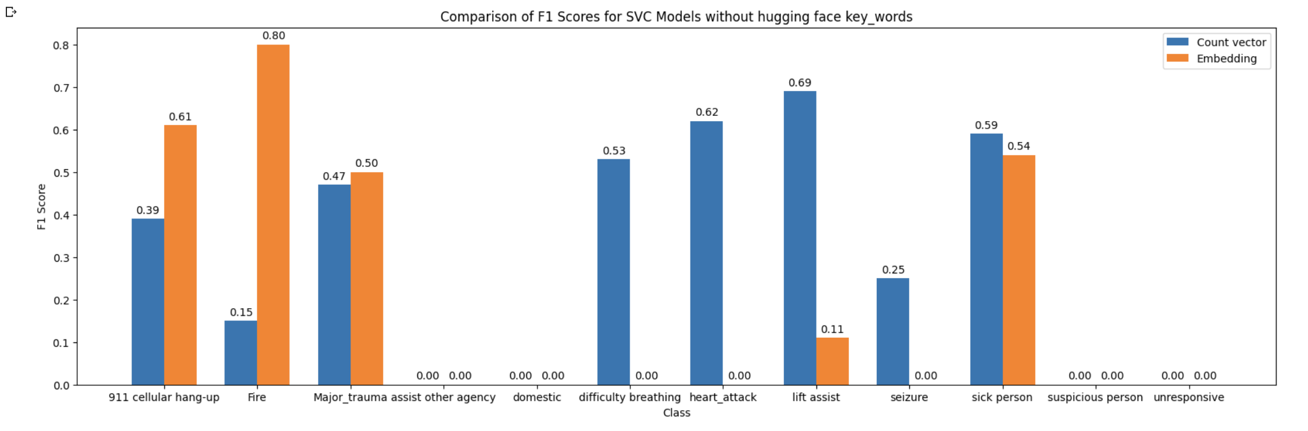
Comparision:
SVC USING EMBEDDINGS AND COUNT-VECTOR.

Slide 18
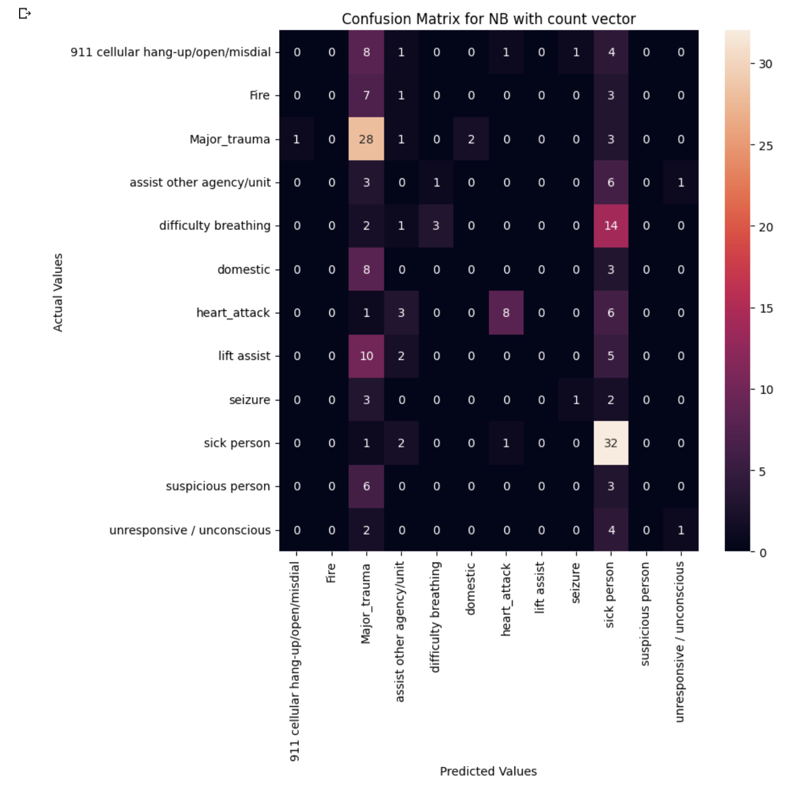
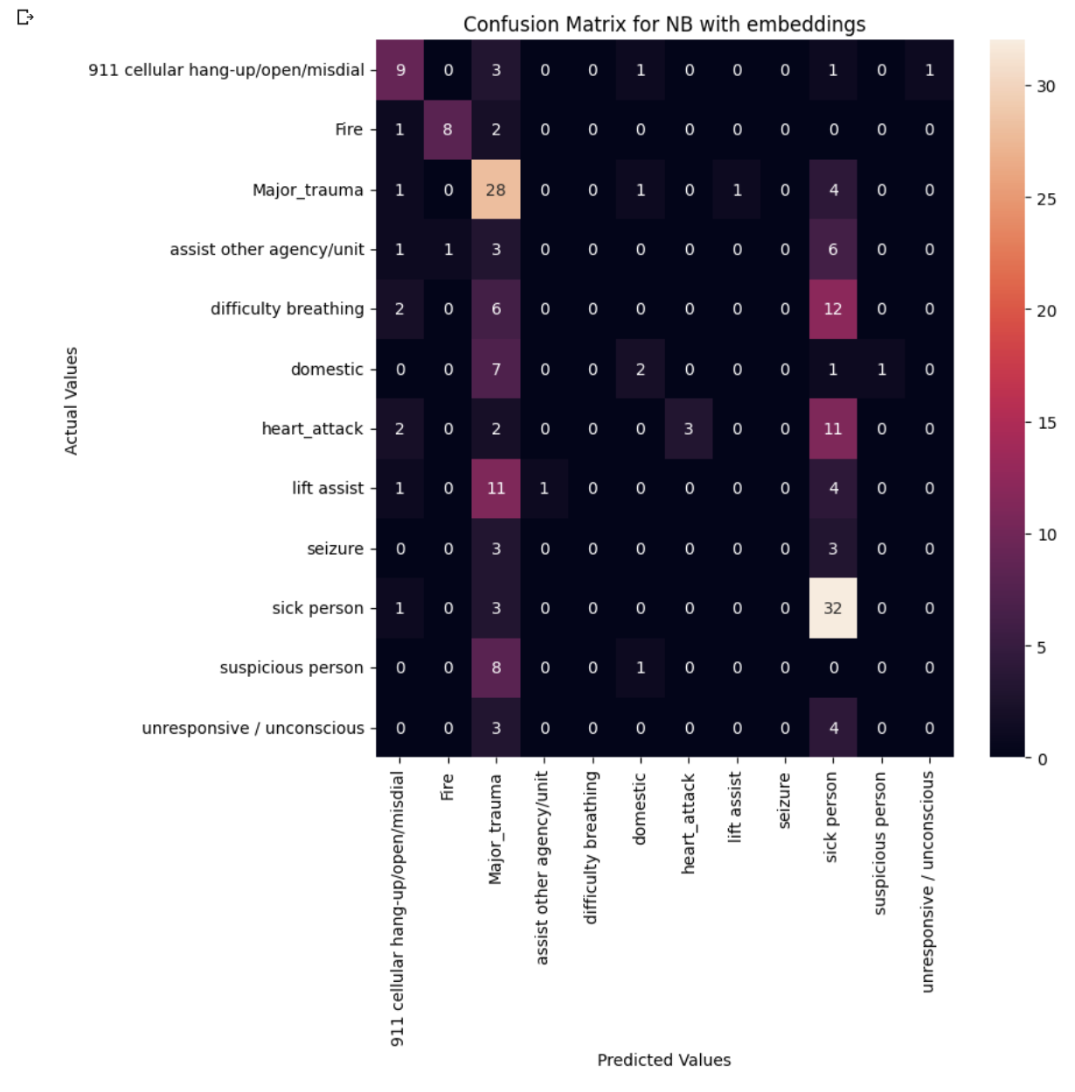
Confusion Matrices for NB:

Slide 19
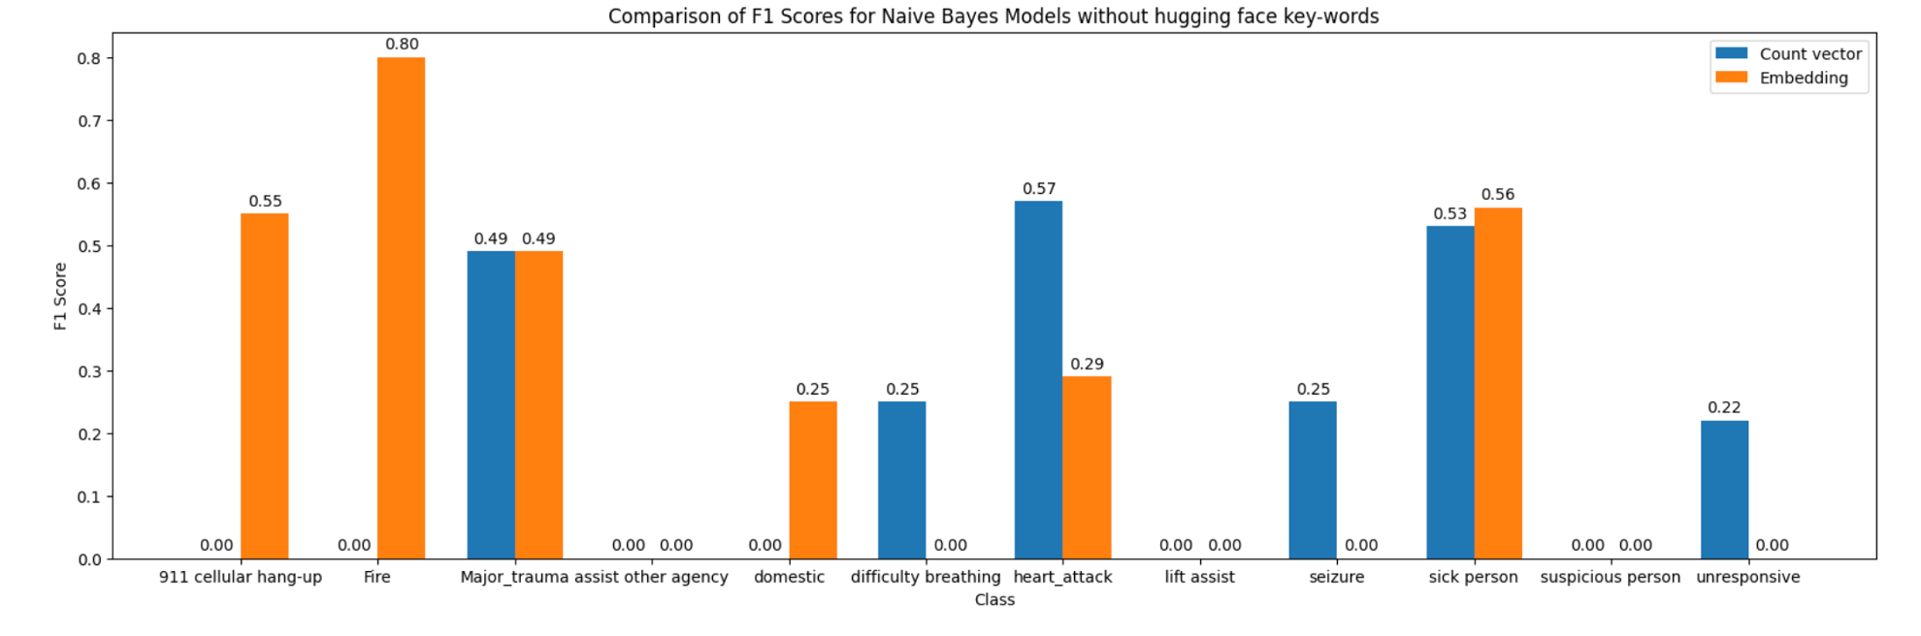
Comparision:
NB USING EMBEDDINGS AND COUNT-VECTOR.

Slide 20
Hugging Face Model:
The en_ner_bc5cdr_md model is a named entity recognition (NER) model for the English language.
Specifically, it is trained on the biomedical domain using the BioCreative V Chemical Disease Relation (BC5CDR) corpus, which consists of over 1500 PubMed articles annotated for chemical and disease entities and their relationships.
The model is pre-trained on a large corpus of biomedical text and can be fine-tuned on specific tasks and domains as needed.
The model is used to extract two different columns to the data set:
Key_words_chemicals
Key_words_disease

Slide 21
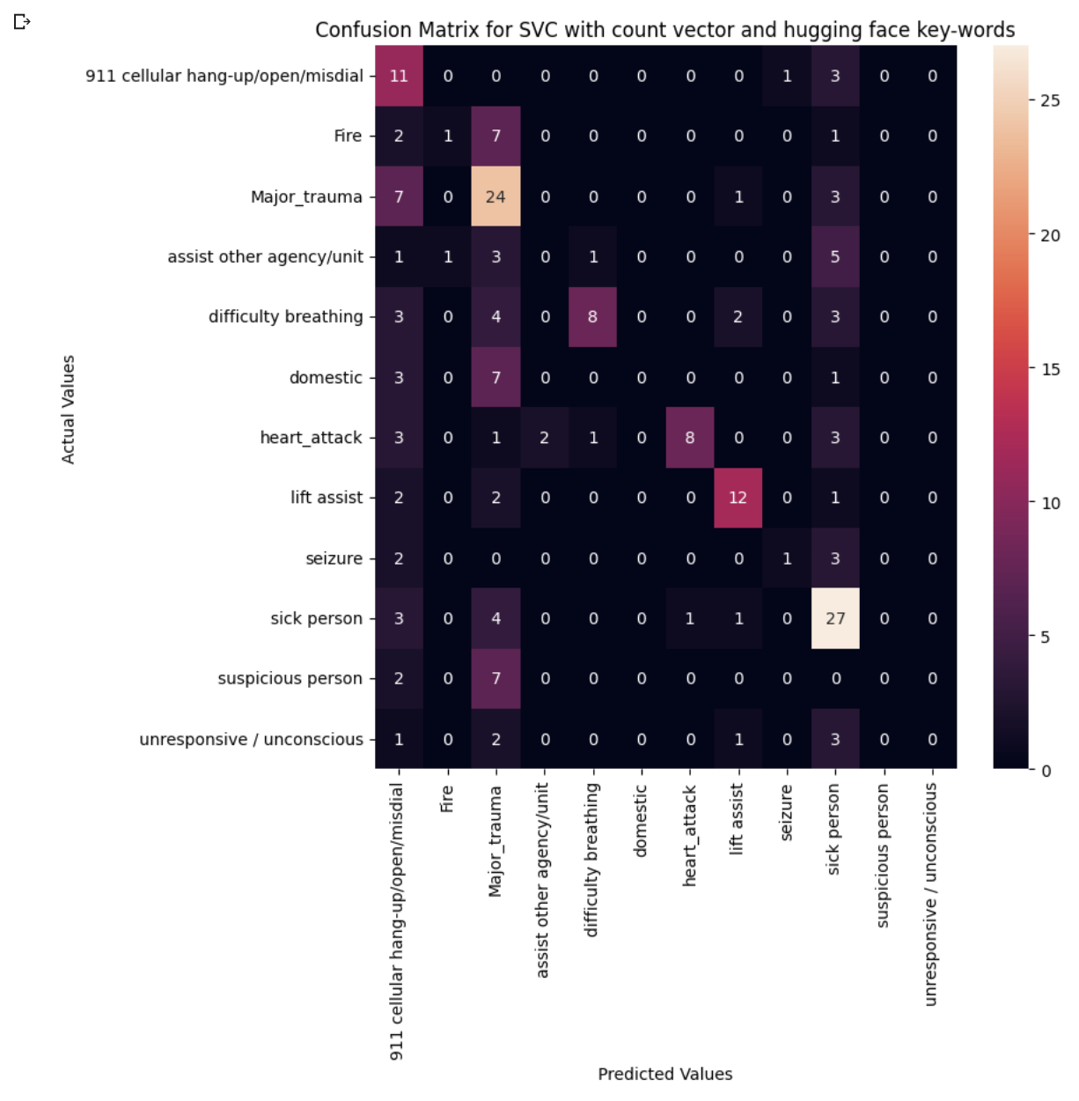
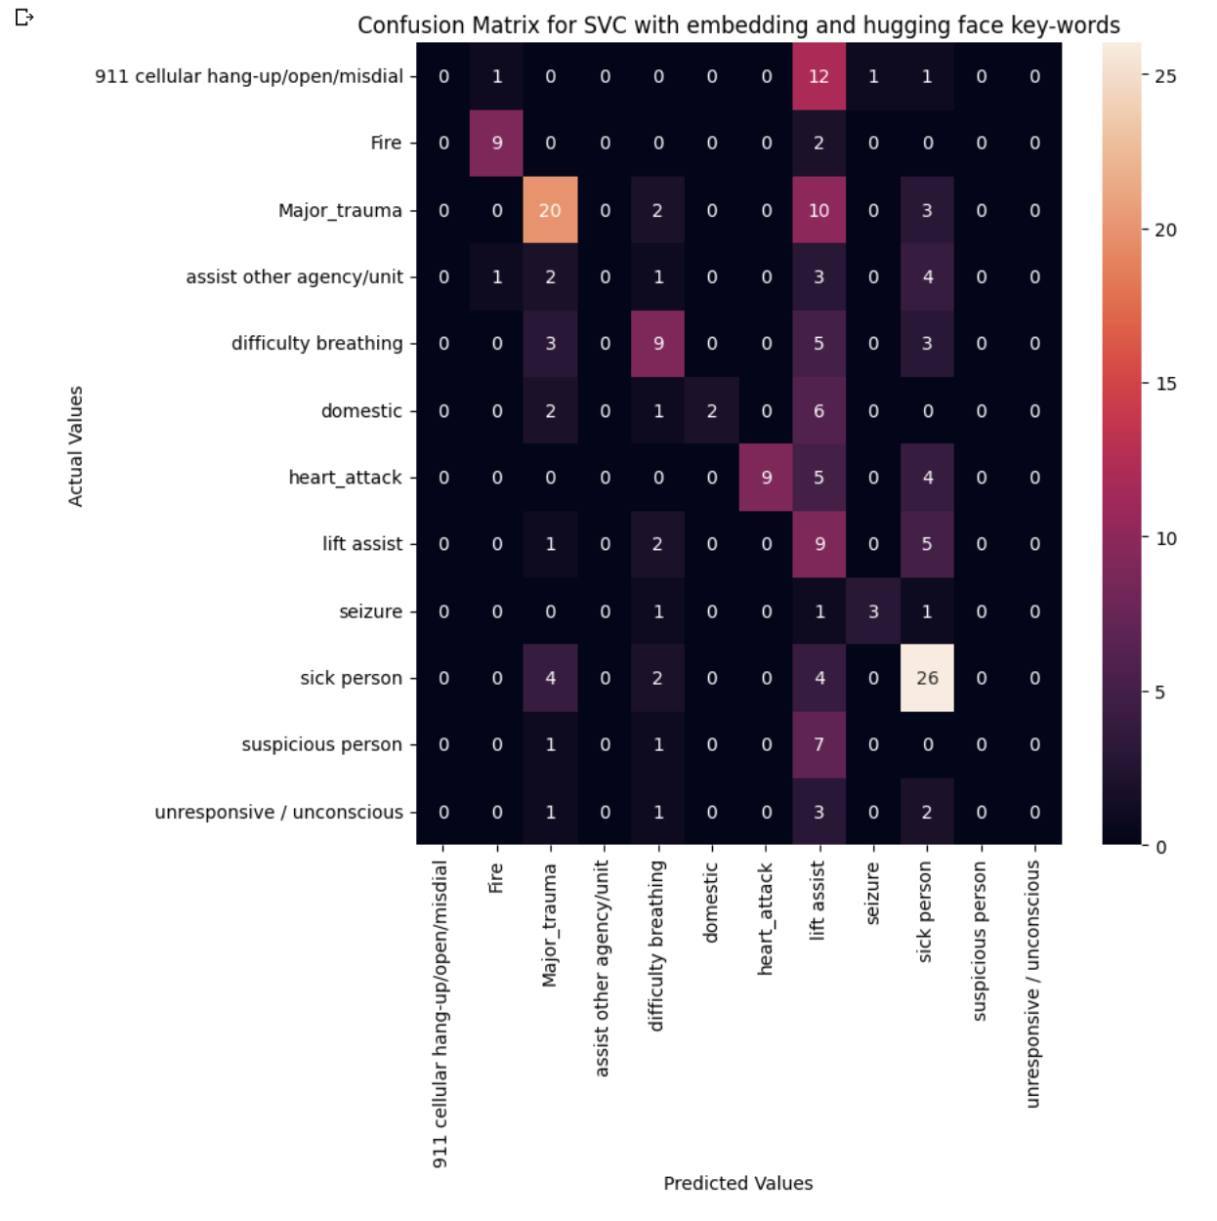
Confusion Matrices for SVC (Hugging Face):

Slide 22
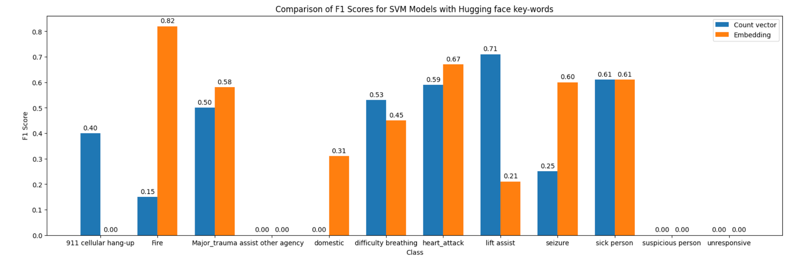
Comparision:
SVC USING EMBEDDINGS AND COUNT-VECTOR WITH HUGGING FACE KEY-WORDS.

Slide 23
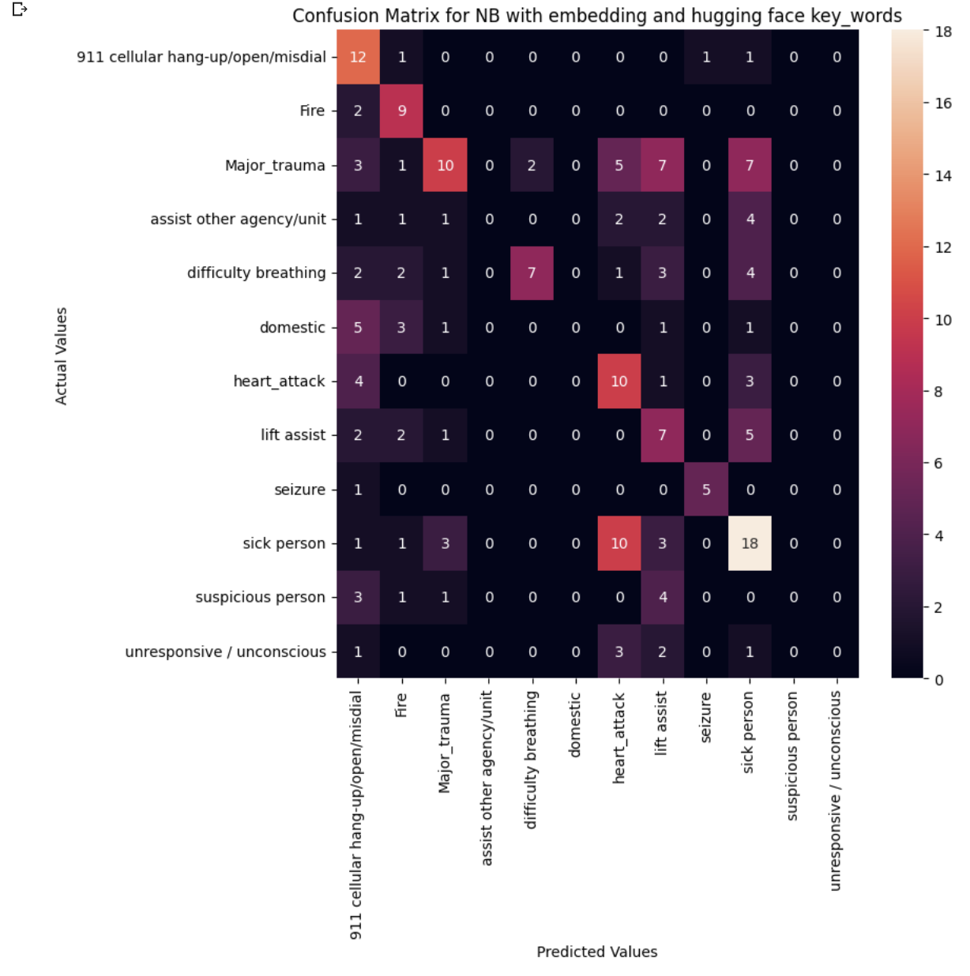
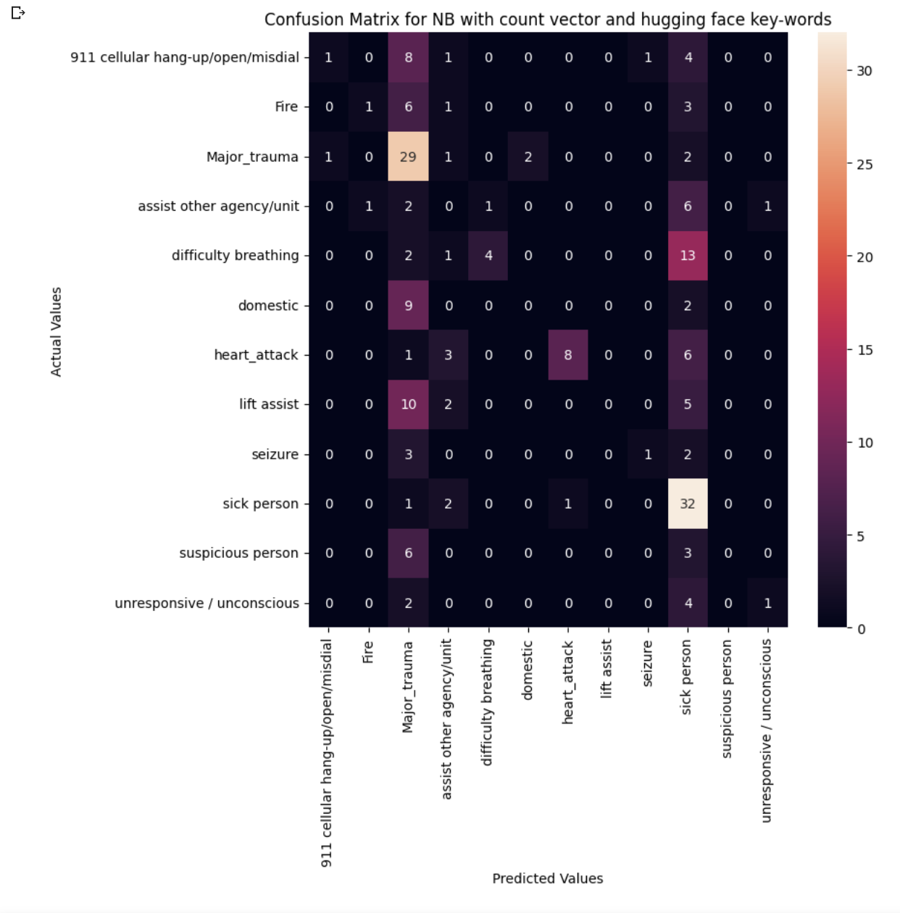
Confusion Matrices for NB (Hugging Face):

Slide 24
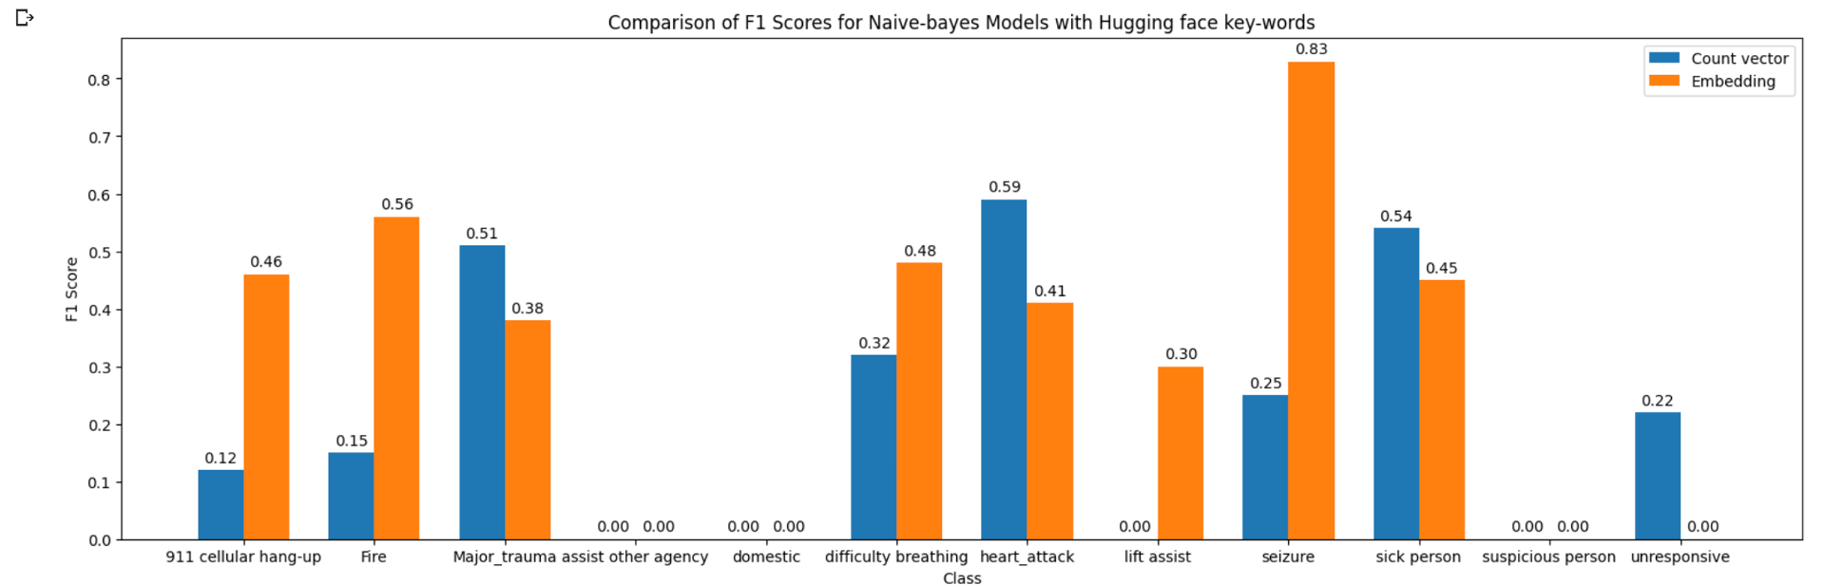
Comparision:
NB USING EMBEDDINGS AND COUNT-VECTOR WITH HUGGING FACE KEY-WORDS.

Slide 25
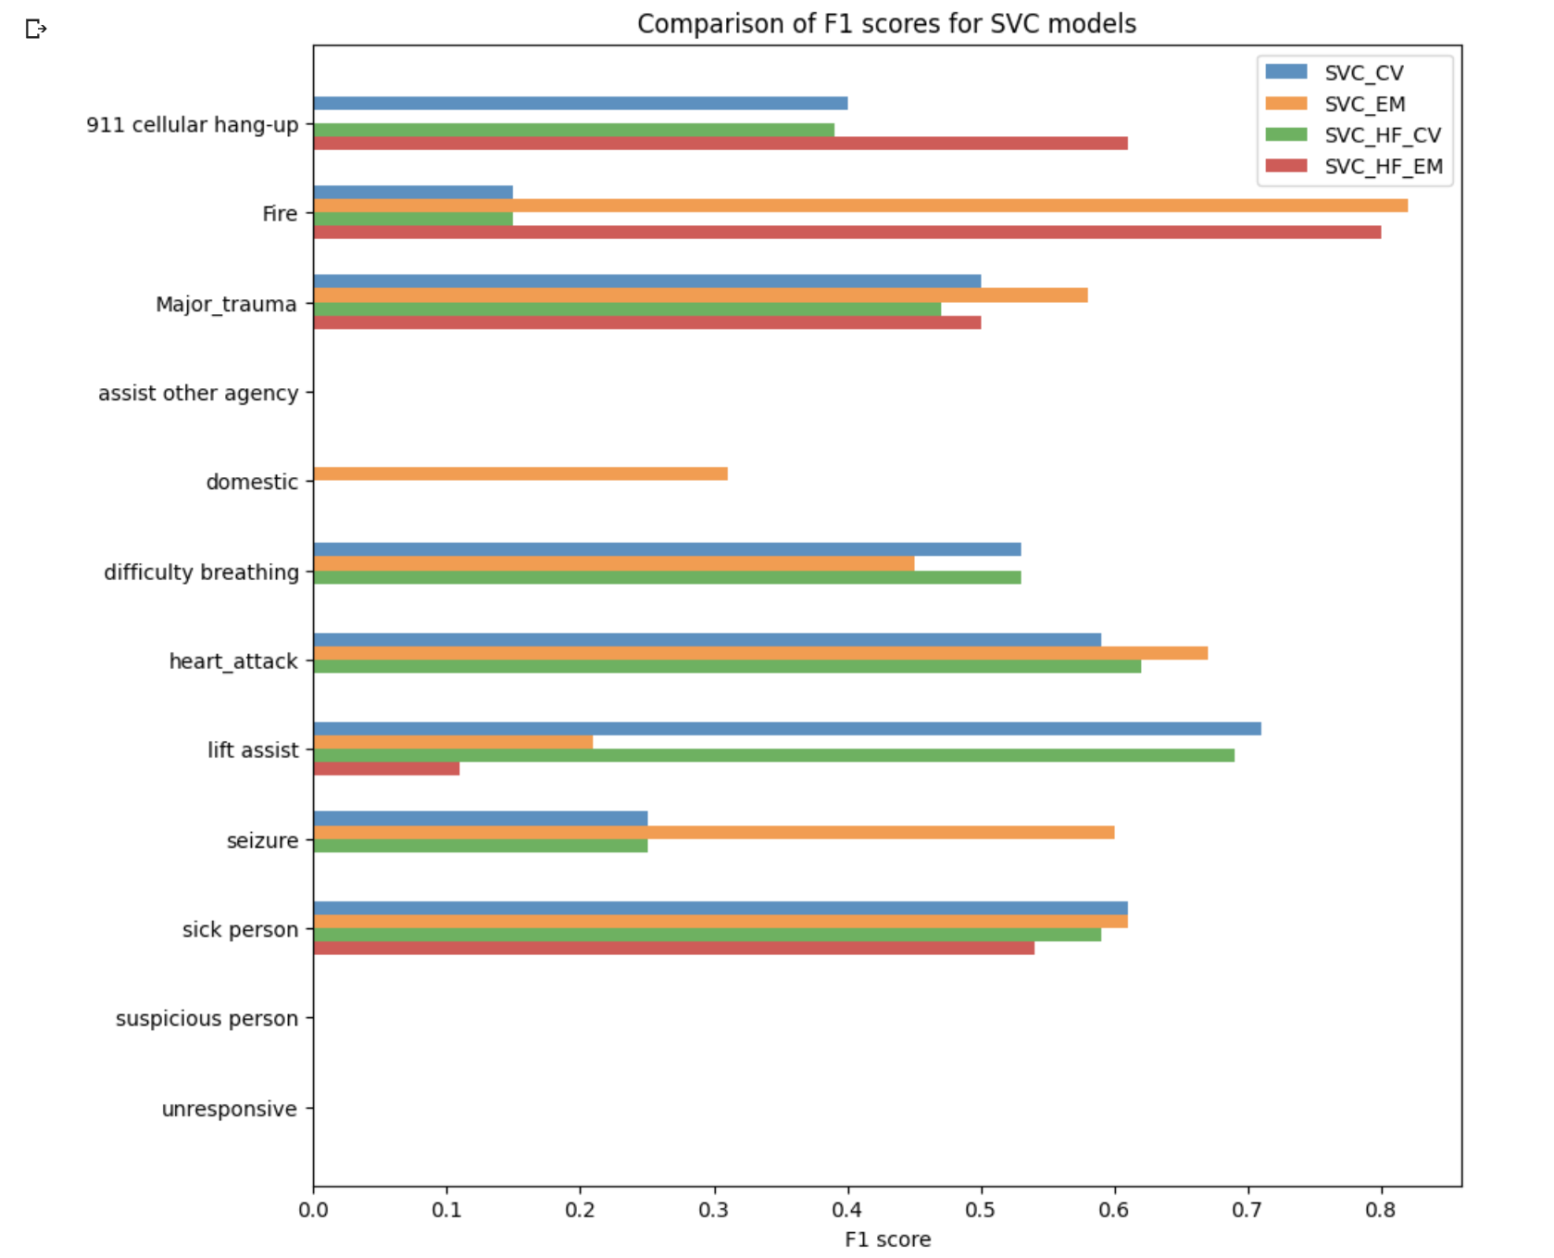
F1-Scores for SVC Models:

Slide 26
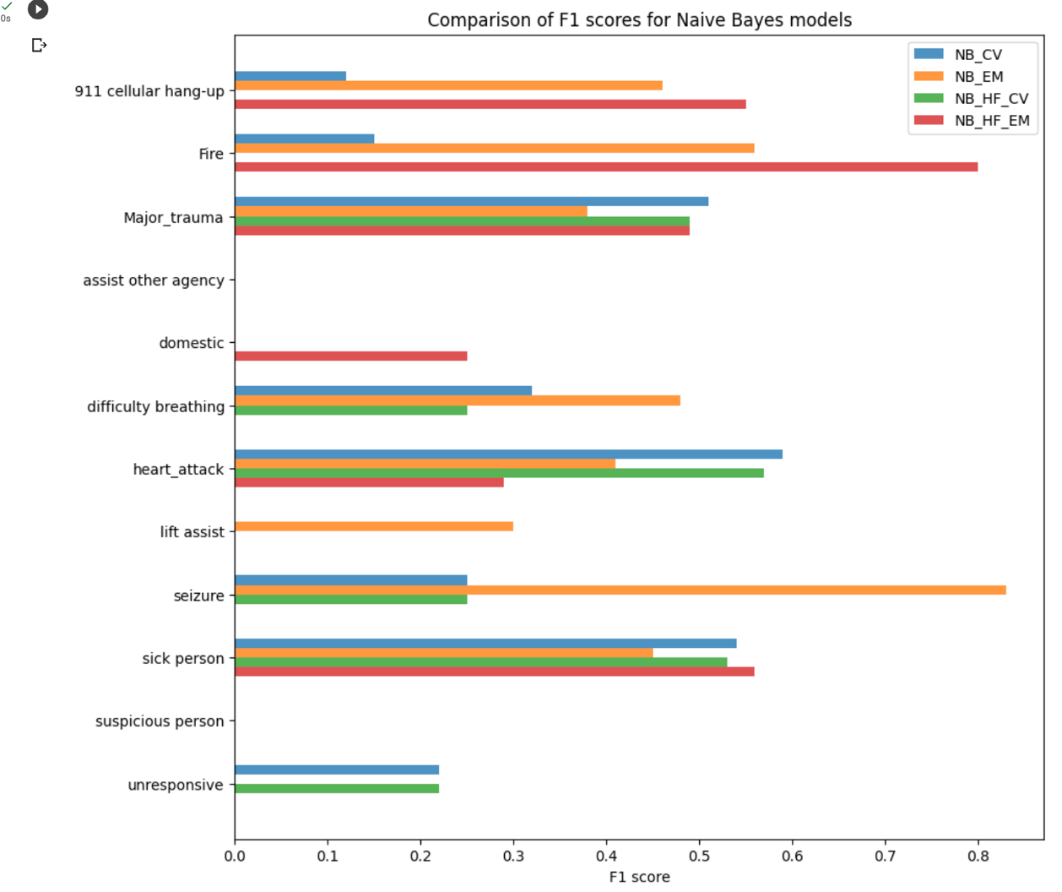
F1-Scores for NB Models:

Slide 27
Results and Discussion:
By comparing different outputs from the models with several combinations, we conclude that both the models SVC and NB perform the similarly on the dataset.
There is an improvement when embeddings are used instead of count vectors.
Even though the f1-scores improve drastically for certain categories after using hugging face key words, the f1 score remains zero for some categories due to class imbalance.
Using Cosine similarity improved our results compared to fuzzy logic. Nevertheless, using KNN over cosine similarity provided us with much better results.

Slide 28
Strengths and Weaknesses of methods:
KNN over cosine similarity is working better for address matching:
KNN with cosine similarity is a powerful method for measuring similarity between texts,and is widely used in natural language processing and information retrieval tasks.
More effective than other similarity measures, such as Euclidean distance, for text-based applications because it accounts for the relative importance of words in a document.
Can be sensitive to the choice of text preprocessing techniques, such as stopword removal and stemming, which can affect the similarity measure between texts.
Can be computationally expensive for large datasets, as it requires calculating the cosine similarity between each pair of texts.
Can be affected by the sparsity of the dataset.
Count Vectorizer:
It counts the frequency of each token in each document and creates a matrix where each row represents a document and each column represents a token in the vocabulary.
CountVectorizer generates a sparse matrix where most of the entries are zero, as most words are not present in most documents. This can lead to computational inefficiencies and can require additional processing to reduce the dimensionality of the data.

Slide 29
Strengths and Weaknesses of methods:
Embeddings:
Embeddings can be used as input to machine learning models or as a pre-processing step to transform text data into a more structured and meaningful representation.
Capture the statistical relationships between words based on the context in which they appear.
Embeddings are typically learned from large amounts of text data, but may not have representations for all words in a given vocabulary. This can lead to missing or inaccurate representations for rare or out-of-vocabulary words.
Use of hugging face model with embedding to provide additional semantic information improved the model's results:
The hugging face model is a pre-trained model that can be fine-tuned for a specific task, which can improve performance.
The hugging face model may not be able to capture all the nuances of language and may struggle with humanized expressions.
It was unable to improve results significantly for the classes with small number of instances in dataset.

Slide 30
Hypothesis Validation:
Initially we had hypothesized that implementation of natural language processing techniques in the analysis of 9-1-1 calls will enable the development of a machine learning model that can improve the efficiency of 9-1-1 care centers. Currently we are able to build entire pipeline for this. Each section in the pipeline is performing as per expectations and we are working on improvements of results and its automation.
Once automated, it is likely that the model will be able to correctly classify the calls and improve the efficiency of 9-1-1 care centers. Hence, the hypothesis provided initially underlines the work and system built in the project.

Slide 31
Future Work:
Continue to enhance address extraction process
Obtain more data to help train the model better
Build a real time model
Apply the model at a dispatch centre
Create a scoring system to measure the quality of the dispatcher's decision-making process

Slide 32
References:
Terrell, I. S., McNeese, M. D., & Jefferson Jr, T. (2004, September). Exploring cognitive work within a 911 dispatch center: Using complementary knowledge elicitation techniques. In Proceedings of the Human Factors and Ergonomics Society Annual Meeting (Vol. 48, No. 3, pp. 605-609). Sage CA: Los Angeles, CA: SAGE Publications.
Moser, A., Mettler, A., Fuchs, V., Hanhart, W., Robert, C. F., Della Santa, V., & Dami, F. (2017). Merger of two dispatch centres: does it improve quality and patient safety?. Scandinavian journal of trauma, resuscitation and emergency medicine, 25(1), 40. https://doi.org/10.1186/s13049-017-0383-z
Deakin, C. D., England, S., & Diffey, D. (2017). Ambulance telephone triage using 'NHS Pathways' to identify adult cardiac arrest. Heart (British Cardiac Society), 103(10), 738–744. https://doi.org/10.1136/heartjnl-2016-310651
Stipulante, S., Tubes, R., El Fassi, M., Donneau, A. F., Van Troyen, B., Hartstein, G., D'Orio, V., & Ghuysen, A. (2014). Implementation of the ALERT algorithm, a new dispatcher-assisted telephone cardiopulmonary resuscitation protocol, in non-Advanced Medical Priority Dispatch System (AMPDS) Emergency Medical Services centres. Resuscitation, 85(2), 177–181. https://doi.org/10.1016/j.resuscitation.2013.10.005
Neusteter, S. R., Mapolski, M., Khogali, M., & O'Toole, M. (2019). The 911 call processing system: A review of the literature as it relates to policing.
Ellington, B. (2004). Enhancing 911 Systems A Usability Test Plan. AMCIS 2004 Proceedings, 430.
Foroughi, C. (2020). Understanding the Data Gap in Emergency Response: Evidence from US 911 Agencies. Available at SSRN 3633580.
Larson, R. C., & McLaren. (1985). The future of police emergency response systems. NIJ Reports.
Scott, M. (2003). State-of-the-Art Dispatch Centers. Law and Order, 51(8), 52-54.
Williamson C, Kelly P, Strain T. Different analysis methods of Scottish and English child physical activity data explain the majority of the difference between the national prevalence estimates. BMC Public Health. 2019 Feb 11;19(1):171. doi: 10.1186/s12889-019-6517-7. PMID: 30744604; PMCID: PMC6371508.

Slide 33
:
THANK YOU!

